Slide 1
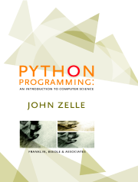
Python Programming:
An Introduction to
Computer Science
Chapter 7
Decision Structures
Python Programming, 1/e

Slide 2
Objectives
To understand the programming pattern simple decision and its implementation using a Python if statement.
To understand the programming pattern two-way decision and its implementation using a Python if-else statement.
Python Programming, 1/e

Slide 3
Objectives (cont.)
To understand the programming pattern multi-way decision and its implementation using a Python if-elif-else statement.
To understand the idea of exception handling and be able to write simple exception handling code that catches standard Python run-time errors.
Python Programming, 1/e

Slide 4
Objectives (cont.)
To understand the concept of Boolean expressions and the bool data type (requires Python 2.3 and newer)
To be able to read, write, and implement algorithms that employ decision structures, including those that employ sequences of decisions and nested decision structures.
Python Programming, 1/e

Slide 5
Simple Decisions
So far, we’ve viewed programs as sequences of instructions that are followed one after the other.
While this is a fundamental programming concept, it is not sufficient in itself to solve every problem. We need to be able to alter the sequential flow of a program to suit a particular situation.
Python Programming, 1/e
Notes:
Python Programming, 1/e

Slide 6
Simple Decisions
Control structures allow us to alter this sequential program flow.
In this chapter, we’ll learn about decision structures, which are statements that allow a program to execute different sequences of instructions for different cases, allowing the program to “choose” an appropriate course of action.
Python Programming, 1/e

Slide 7
Example:
Temperature Warnings
Let’s return to our Celsius to Fahrenheit temperature conversion program from Chapter 2.
# convert.py
# A program to convert Celsius temps to Fahrenheit
# by: Susan Computewell
def main():
celsius = input("What is the Celsius temperature? ")
fahrenheit = 9.0 / 5.0 * celsius + 32
print "The temperature is", fahrenheit, "degrees Fahrenheit."
main()
Python Programming, 1/e

Slide 8
Example:
Temperature Warnings
Let’s say we want to modify that program to print a warning when the weather is extreme.
Any temperature over 90 degrees Fahrenheit and lower than 30 degrees Fahrenheit will cause a hot and cold weather warning, respectively.
Python Programming, 1/e

Slide 9
Example:
Temperature Warnings
Input the temperature in degrees Celsius (call it celsius)
Calculate fahrenheit as 9/5 celsius + 32
Output fahrenheit
If fahrenheit > 90
print a heat warning
If fahrenheit > 30
print a cold warning
Python Programming, 1/e

Slide 10
Example:
Temperature Warnings
This new algorithm has two decisions at the end. The indentation indicates that a step should be performed only if the condition listed in the previous line is true.
Python Programming, 1/e

Slide 11
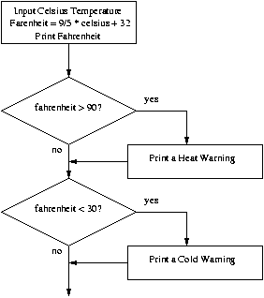
Example:
Temperature Warnings
Python Programming, 1/e

Slide 12
Example:
Temperature Warnings
# convert2.py
# A program to convert Celsius temps to Fahrenheit.
# This version issues heat and cold warnings.
def main():
celsius = input("What is the Celsius temperature? ")
fahrenheit = 9.0 / 5.0 * celsius + 32
print "The temperature is", fahrenheit, "degrees fahrenheit."
if fahrenheit >= 90:
print "It's really hot out there, be careful!"
if fahrenheit <= 30:
print "Brrrrr. Be sure to dress warmly"
main()
Python Programming, 1/e

Slide 13
Example:
Temperature Warnings
The Python if statement is used to implement the decision.
if <condition>:
<body>
The body is a sequence of one or more statements indented under the if heading.
Python Programming, 1/e

Slide 14
Example:
Temperature Warnings
The semantics of the if should be clear.
  First, the condition in the heading is evaluated.
  If the condition is true, the sequence of statements in the body is executed, and then control passes to the next statement in the program.
  If the condition is false, the statements in the body are skipped, and control passes to the next statement in the program.
Python Programming, 1/e

Slide 15
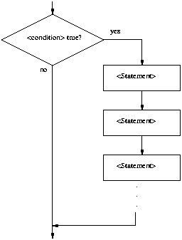
Example:
Temperature Warnings
Python Programming, 1/e

Slide 16
Example:
Temperature Warnings
The body of the if either executes or not depending on the condition. In any case, control then passes to the next statement after the if.
This is a one-way or simple decision.
Python Programming, 1/e

Slide 17
Forming Simple Conditions
What does a condition look like?
At this point, let’s use simple comparisons.
<expr> <relop> <expr>
<relop> is short for relational operator
Python Programming, 1/e

Slide 18
Forming Simple Conditions
Python | Mathematics | Meaning
< | < | Less than
<= | ≤ | Less than or equal to
== | = | Equal to
>= | ≥ | Greater than or equal to
> | > | Greater than
!= | ≠ | Not equal to
Python Programming, 1/e

Slide 19
Forming Simple Conditions
Notice the use of == for equality. Since Python uses = to indicate assignment, a different symbol is required for the concept of equality.
A common mistake is using = in conditions!
Python Programming, 1/e

Slide 20
Forming Simple Conditions
Conditions may compare either numbers or strings.
When comparing strings, the ordering is lexigraphic, meaning that the strings are sorted based on the underlying ASCII codes. Because of this, all upper-case letters come before lower-case letters. (“Bbbb” comes before “aaaa”)
Python Programming, 1/e

Slide 21
Forming Simple Conditions
Conditions are based on Boolean expressions, named for the English mathematician George Boole.
When a Boolean expression is evaluated, it produces either a value of true (meaning the condition holds), or it produces false (it does not hold).
Some computer languages use 1 and 0 to represent “true” and “false”.
Python Programming, 1/e

Slide 22
Forming Simple Conditions
Boolean conditions are of type bool and the Boolean values of true and false are represented by the literals True and False.
>>> 3 < 4
True
>>> 3 * 4 < 3 + 4
False
>>> "hello" == "hello"
True
>>> "Hello" < "hello"
True
Python Programming, 1/e

Slide 23
Example: Conditional Program Execution
There are several ways of running Python programs.
  Some modules are designed to be run directly. These are referred to as programs or scripts.
  Others are made to be imported and used by other programs. These are referred to as libraries.
  Sometimes we want to create a hybrid that can be used both as a stand-alone program and as a library.
Python Programming, 1/e

Slide 24
Example: Conditional Program Execution
When we want to start a program once it’s loaded, we include the line main()
at the bottom of the code.
Since Python evaluates the lines of the program during the import process, our current programs also run when they are imported into an interactive Python session or into another Python program.
Python Programming, 1/e

Slide 25
Example: Conditional Program Execution
Generally, when we import a module, we don’t want it to execute!
In a program that can be either run stand-alone or loaded as a library, the call to main at the bottom should be made conditional, e.g.
if <condition>:
main()
Python Programming, 1/e

Slide 26
Example: Conditional Program Execution
Whenever a module is imported, Python creates a special variable in the module called __name__ to be the name of the imported module.
Example:
>>> import math
>>> math.__name__
'math'
Python Programming, 1/e

Slide 27
Example: Conditional Program Execution
When imported, the __name__ variable inside the math module is assigned the string ‘math’.
When Python code is run directly and not imported, the value of __name__ is ‘__main__’. E.g.:
>>> __name__
'__main__'
Python Programming, 1/e

Slide 28
Example: Conditional Program Execution
To recap: if a module is imported, the code in the module will see a variable called __name__ whose value is the name of the module.
When a file is run directly, the code will see the value ‘__main__’.
We can change the final lines of our programs to:
if __name__ == '__main__':
main()
Virtually every Python module ends this way!
Python Programming, 1/e

Slide 29
Two-Way Decisions
Let’s look at the quadratic program as we left it.
# quadratic.py
# A program that computes the real roots of a quadratic equation.
# Illustrates use of the math library.
# Note: This program crashes if the equation has no real roots.
import math # Makes the math library available.
def main():
print "This program finds the real solutions to a quadratic"
print
a, b, c = input("Please enter the coefficients (a, b, c): ")
discRoot = math.sqrt(b * b - 4 * a * c)
root1 = (-b + discRoot) / (2 * a)
root2 = (-b - discRoot) / (2 * a)
print
print "The solutions are:", root1, root2
main()
Python Programming, 1/e

Slide 30
Two-Way Decisions
As the comment implies, when
b²-4ac < 0, the program tries to take the square root of a negative number, and then crashes.
This program finds the real solutions to a quadratic
Please enter the coefficients (a, b, c): 1,1,2
Traceback (most recent call last):
File "C:\Documents and Settings\Terry\My Documents\Teaching\W04\CS 120\Textbook\code\chapter3\quadratic.py", line 21, in -toplevel-
main()
File "C:\Documents and Settings\Terry\My Documents\Teaching\W04\CS 120\Textbook\code\chapter3\quadratic.py", line 14, in main
discRoot = math.sqrt(b * b - 4 * a * c)
ValueError: math domain error
Python Programming, 1/e

Slide 31
Two-Way Decisions
We can check for this situation. Here’s our first attempt.
# quadratic2.py
# A program that computes the real roots of a quadratic equation.
# Bad version using a simple if to avoid program crash
import math
def main():
print "This program finds the real solutions to a quadratic\n"
a, b, c = input("Please enter the coefficients (a, b, c): ")
discrim = b * b - 4 * a * c
if discrim >= 0:
discRoot = math.sqrt(discrim)
root1 = (-b + discRoot) / (2 * a)
root2 = (-b - discRoot) / (2 * a)
print "\nThe solutions are:", root1, root2
Python Programming, 1/e

Slide 32
Two-Way Decisions
We first calculate the discriminant
(b²-4ac) and then check to make sure it’s nonnegative. If it is, the program proceeds and we calculate the roots.
Look carefully at the program. What’s wrong with it? Hint: What happens when there are no real roots?
Python Programming, 1/e

Slide 33
Two-Way Decisions
This program finds the real solutions to a quadratic
Please enter the coefficients (a, b, c): 1,1,1
>>>
This is almost worse than the version that crashes, because we don’t know what went wrong!
Python Programming, 1/e

Slide 34
Two-Way Decisions
We could add another if to the end:
if discrim < 0:
print "The equation has no real roots!"
This works, but feels wrong. We have two decisions, with mutually exclusive outcomes (if discrim >= 0 then discrim < 0 must be false, and vice versa).
Python Programming, 1/e

Slide 35
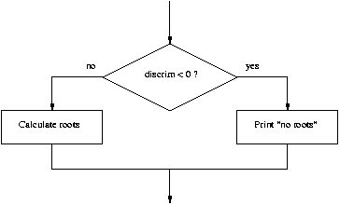
Two-Way Decisions
Python Programming, 1/e

Slide 36
Two-Way Decisions
In Python, a two-way decision can be implemented by attaching an else clause onto an if clause.
This is called an if-else statement:
if <condition>:
<statements>
else:
<statements>
Python Programming, 1/e

Slide 37
Two-Way Decisions
When Python first encounters this structure, it first evaluates the condition. If the condition is true, the statements under the if are executed.
If the condition is false, the statements under the else are executed.
In either case, the statements following the if-else are executed after either set of statements are executed.
Python Programming, 1/e

Slide 38
Two-Way Decisions
# quadratic3.py
# A program that computes the real roots of a quadratic equation.
# Illustrates use of a two-way decision
import math
def main():
print "This program finds the real solutions to a quadratic\n"
a, b, c = input("Please enter the coefficients (a, b, c): ")
discrim = b * b - 4 * a * c
if discrim < 0:
print "\nThe equation has no real roots!"
else:
discRoot = math.sqrt(b * b - 4 * a * c)
root1 = (-b + discRoot) / (2 * a)
root2 = (-b - discRoot) / (2 * a)
print "\nThe solutions are:", root1, root2
main()
Python Programming, 1/e

Slide 39
Two-Way Decisions
>>>
This program finds the real solutions to a quadratic
Please enter the coefficients (a, b, c): 1,1,2
The equation has no real roots!
>>>
This program finds the real solutions to a quadratic
Please enter the coefficients (a, b, c): 2, 5, 2
The solutions are: -0.5 -2.0
Python Programming, 1/e

Slide 40
Multi-Way Decisions
The newest program is great, but it still has some quirks!
This program finds the real solutions to a quadratic
Please enter the coefficients (a, b, c): 1,2,1
The solutions are: -1.0 -1.0
Python Programming, 1/e

Slide 41
Multi-Way Decisions
While correct, this method might be confusing for some people. It looks like it has mistakenly printed the same number twice!
Double roots occur when the discriminant is exactly 0, and then the roots are –b/2a.
It looks like we need a three-way decision!
Python Programming, 1/e

Slide 42
Multi-Way Decisions
Check the value of discrim
when < 0: handle the case of no roots
when = 0: handle the case of a double root
when > 0: handle the case of two distinct roots
We can do this with two if-else statements, one inside the other.
Putting one compound statement inside of another is called nesting.
Python Programming, 1/e

Slide 43
Multi-Way Decisions
if discrim < 0:
print "Equation has no real roots"
else:
if discrim == 0:
root = -b / (2 * a)
print "There is a double root at", root
else:
# Do stuff for two roots
Python Programming, 1/e

Slide 44
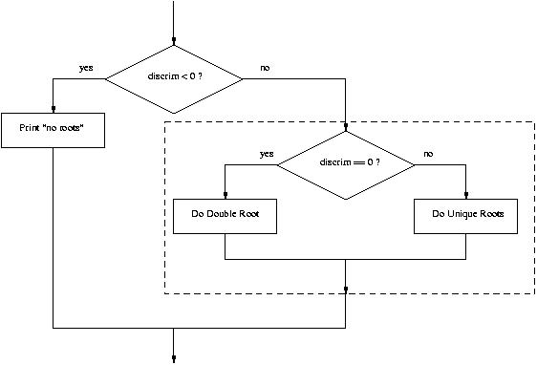
Multi-Way Decisions
Python Programming, 1/e

Slide 45
Multi-Way Decisions
Imagine if we needed to make a five-way decision using nesting. The if-else statements would be nested four levels deep!
There is a construct in Python that achieves this, combining an else followed immediately by an if into a single elif.
Python Programming, 1/e

Slide 46
Multi-Way Decisions
if <condition1>:
<case1 statements>
elif <condition2>:
<case2 statements>
elif <condition3>:
<case3 statements>
…
else:
<default statements>
Python Programming, 1/e

Slide 47
Multi-Way Decisions
This form sets of any number of mutually exclusive code blocks.
Python evaluates each condition in turn looking for the first one that is true. If a true condition is found, the statements indented under that condition are executed, and control passes to the next statement after the entire if-elif-else.
If none are true, the statements under else are performed.
Python Programming, 1/e

Slide 48
Multi-Way Decisions
The else is optional. If there is no else, it’s possible no indented block would be executed.
Python Programming, 1/e

Slide 49
Multi-Way Decisions
# quadratic4.py
# A program that computes the real roots of a quadratic equation.
# Illustrates use of a multi-way decision
import math
def main():
print "This program finds the real solutions to a quadratic\n"
a, b, c = input("Please enter the coefficients (a, b, c): ")
discrim = b * b - 4 * a * c
if discrim < 0:
print "\nThe equation has no real roots!"
elif discrim == 0:
root = -b / (2 * a)
print "\nThere is a double root at", root
else:
discRoot = math.sqrt(b * b - 4 * a * c)
root1 = (-b + discRoot) / (2 * a)
root2 = (-b - discRoot) / (2 * a)
print "\nThe solutions are:", root1, root2
Python Programming, 1/e

Slide 50
Exception Handling
In the quadratic program we used decision structures to avoid taking the square root of a negative number, thus avoiding a run-time error.
This is true for many programs: decision structures are used to protect against rare but possible errors.
Python Programming, 1/e

Slide 51
Exception Handling
In the quadratic example, we checked the data before calling sqrt. Sometimes functions will check for errors and return a special value to indicate the operation was unsuccessful.
E.g., a different square root operation might return a –1 to indicate an error (since square roots are never negative, we know this value will be unique).
Python Programming, 1/e

Slide 52
Exception Handling
discRt = otherSqrt(b*b - 4*a*c)
if discRt < 0:
print "No real roots.“
else:
...
Sometimes programs get so many checks for special cases that the algorithm becomes hard to follow.
Programming language designers have come up with a mechanism to handle exception handling to solve this design problem.
Python Programming, 1/e

Slide 53
Exception Handling
The programmer can write code that catches and deals with errors that arise while the program is running, I.e., “Do these steps, and if any problem crops up, handle it this way.”
This approach obviates the need to do explicit checking at each step in the algorithm.
Python Programming, 1/e

Slide 54
Exception Handling
# quadratic5.py
# A program that computes the real roots of a quadratic equation.
# Illustrates exception handling to avoid crash on bad inputs
import math
def main():
print "This program finds the real solutions to a quadratic\n"
try:
a, b, c = input("Please enter the coefficients (a, b, c): ")
discRoot = math.sqrt(b * b - 4 * a * c)
root1 = (-b + discRoot) / (2 * a)
root2 = (-b - discRoot) / (2 * a)
print "\nThe solutions are:", root1, root2
except ValueError:
print "\nNo real roots"
Python Programming, 1/e

Slide 55
Exception Handling
The try statement has the following form:
try:
<body>
except <ErrorType>:
<handler>
When Python encounters a try statement, it attempts to execute the statements inside the body.
If there is no error, control passes to the next statement after the try…except.
Python Programming, 1/e

Slide 56
Exception Handling
If an error occurs while executing the body, Python looks for an except clause with a matching error type. If one is found, the handler code is executed.
The original program generated this error with a negative discriminant:
Traceback (most recent call last):
File "C:\Documents and Settings\Terry\My Documents\Teaching\W04\CS120\Textbook\code\chapter3\quadratic.py", line 21, in -toplevel-
main()
File "C:\Documents and Settings\Terry\My Documents\Teaching\W04\CS 120\Textbook\code\chapter3\quadratic.py", line 14, in main
discRoot = math.sqrt(b * b - 4 * a * c)
ValueError: math domain error
Python Programming, 1/e

Slide 57
Exception Handling
The last line, “ValueError: math domain error”, indicates the specific type of error.
Here’s the new code in action:
This program finds the real solutions to a quadratic
Please enter the coefficients (a, b, c): 1, 1, 1
No real roots
Instead of crashing, the exception handler prints a message indicating that there are no real roots.
Python Programming, 1/e

Slide 58
Exception Handling
The try…except can be used to catch any kind of error and provide for a graceful exit.
In the case of the quadratic program, other possible errors include not entering the right number of parameters (“unpack tuple of wrong size”), entering an identifier instead of a number (NameError), entering an invalid Python expression (TypeError).
A single try statement can have multiple except clauses.
Python Programming, 1/e

Slide 59
Exception Handling
# quadratic6.py
# A program that computes the real roots of a quadratic equation.
# Illustrates robust exception handling to avoid crash on bad inputs
import math
def main():
print "This program finds the real solutions to a quadratic\n"
try:
a, b, c = input("Please enter the coefficients (a, b, c): ")
discRoot = math.sqrt(b * b - 4 * a * c)
root1 = (-b + discRoot) / (2 * a)
root2 = (-b - discRoot) / (2 * a)
print "\nThe solutions are:", root1, root2
except ValueError, excObj:
msg = str(excObj)
if msg == "math domain error":
print "\nNo Real Roots"
elif msg == "unpack tuple of wrong size":
print "\nYou didn't give me the right number of coefficients."
else:
print "\nSomething went wrong, sorry!"
Python Programming, 1/e

Slide 60
Exception Handling
except NameError:
print "\nYou didn't enter three numbers."
except TypeError:
print "\nYour inputs were not all numbers."
except SyntaxError:
print "\nYour input was not in the correct form. Missing comma(s), perhaps?"
except:
print "\nSomething went wrong, sorry!"
if __name__ == '__main__':
main()
Python Programming, 1/e

Slide 61
Exception Handling
The multiple excepts act like elifs. If an error occurs, Python will try each except looking for one that matches the type of error.
The bare except at the bottom acts like an else and catches any errors without a specific match.
If there was no bare except at the end and none of the except clauses match, the program would still crash and report an error.
Python Programming, 1/e

Slide 62
Exception Handling
Exceptions themselves are a type of object.
If you follow the error type with an identifier in an except clause, Python will assign that identifier the actual exception object.
Python Programming, 1/e

Slide 63
Exception Handling
except ValueError, excObj:
msg = str(excObj)
if msg == "math domain error":
print "\nNo Real Roots"
elif msg == "unpack tuple of wrong size":
print "\nYou didn't give me the right number of coefficients."
else:
print "\nSomething went wrong, sorry!"
Python Programming, 1/e

Slide 64
Study in Design: Max of Three
Now that we have decision structures, we can solve more complicated programming problems. The negative is that writing these programs becomes harder!
Suppose we need an algorithm to find the largest of three numbers.
Python Programming, 1/e

Slide 65
Study in Design: Max of Three
def main():
x1, x2, x3 = input("Please enter three values: ")
# missing code sets max to the value of the largest
print "The largest value is", max
Python Programming, 1/e

Slide 66
Strategy 1:
Compare Each to All
This looks like a three-way decision, where we need to execute one of the following:
max = x1
max = x2
max = x3
All we need to do now is preface each one of these with the right condition!
Python Programming, 1/e

Slide 67
Strategy 1:
Compare Each to All
Let’s look at the case where x1 is the largest.
if x1 >= x2 >= x3:
max = x1
Is this syntactically correct?
  Many languages would not allow this compound condition
  Python does allow it, though. It’s equivalent to
  x1 ≥ x2 ≥ x3.
Python Programming, 1/e

Slide 68
Strategy 1:
Compare Each to All
Whenever you write a decision, there are two crucial questions:
  When the condition is true, is executing the body of the decision the right action to take?
    x1 is at least as large as x2 and x3, so assigning max to x1 is OK.
    Always pay attention to borderline values!!
Python Programming, 1/e

Slide 69
Strategy 1:
Compare Each to All
  Secondly, ask the converse of the first question, namely, are we certain that this condition is true in all cases where x1 is the max?
    Suppose the values are 5, 2, and 4.
    Clearly, x1 is the largest, but does x1 ≥ x2 ≥ x3 hold?
    We don’t really care about the relative ordering of x2 and x3, so we can make two separate tests: x1 >= x2 and x1 >= x3.
Python Programming, 1/e

Slide 70
Strategy 1:
Compare Each to All
We can separate these conditions with and!
if x1 >= x2 and x1 >= x3:
max = x1
elif x2 >= x1 and x2 >= x3:
max = x2
else:
max = x3
We’re comparing each possible value against all the others to determine which one is largest.
Python Programming, 1/e

Slide 71
Strategy 1:
Compare Each to All
What would happen if we were trying to find the max of five values?
We would need four Boolean expressions, each consisting of four conditions anded together.
Yuck!
Python Programming, 1/e

Slide 72
Strategy 2: Decision Tree
We can avoid the redundant tests of the previous algorithm using a decision tree approach.
Suppose we start with x1 >= x2. This knocks either x1 or x2 out of contention to be the max.
If the conidition is true, we need to see which is larger, x1 or x3.
Python Programming, 1/e

Slide 73
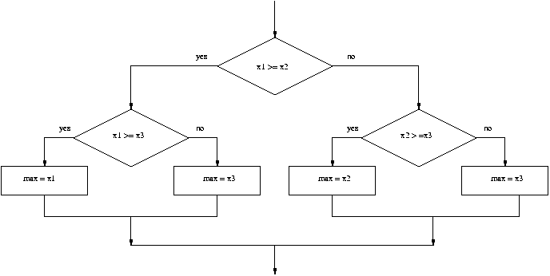
Strategy 2: Decision Tree
Python Programming, 1/e

Slide 74
Strategy 2: Decision Tree
if x1 >= x2:
if x1 >= x3:
max = x1
else:
max = x3
else:
if x2 >= x3:
max = x2
else
max = x3
Python Programming, 1/e

Slide 75
Strategy 2: Decision Tree
This approach makes exactly two comparisons, regardless of the ordering of the original three variables.
However, this approach is more complicated than the first. To find the max of four values you’d need if-elses nested three levels deep with eight assignment statements.
Python Programming, 1/e

Slide 76
Strategy 3:
Sequential Processing
How would you solve the problem?
You could probably look at three numbers and just know which is the largest. But what if you were given a list of a hundred numbers?
One strategy is to scan through the list looking for a big number. When one is found, mark it, and continue looking. If you find a larger value, mark it, erase the previous mark, and continue looking.
Python Programming, 1/e

Slide 77
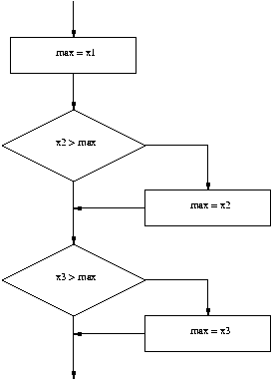
Strategy 3:
Sequential Processing
Python Programming, 1/e

Slide 78
Strategy 3:
Sequential Processing
This idea can easily be translated into Python.
max = x1
if x2 > max:
max = x2
if x3 > max:
max = x3
Python Programming, 1/e

Slide 79
Strategy 3:
Sequential Programming
This process is repetitive and lends itself to using a loop.
We prompt the user for a number, we compare it to our current max, if it is larger, we update the max value, repeat.
Python Programming, 1/e

Slide 80
Strategy 3:
Sequential Programming
# maxn.py
# Finds the maximum of a series of numbers
def main():
n = input("How many numbers are there? ")
# Set max to be the first value
max = input("Enter a number >> ")
# Now compare the n-1 successive values
for i in range(n-1):
x = input("Enter a number >> ")
if x > max:
max = x
print "The largest value is", max
Python Programming, 1/e

Slide 81
Strategy 4:
Use Python
Python has a built-in function called max that returns the largest of its parameters.
def main():
x1, x2, x3 = input("Please enter three values: ")
print "The largest value is", max(x1, x2, x3)
Python Programming, 1/e

Slide 82
Some Lessons
There’s usually more than one way to solve a problem.
  Don’t rush to code the first idea that pops out of your head. Think about the design and ask if there’s a better way to approach the problem.
  Your first task is to find a correct algorithm. After that, strive for clarity, simplicity, efficiency, scalability, and elegance.
Python Programming, 1/e

Slide 83
Some Lessons
Be the computer.
  One of the best ways to formulate an algorithm is to ask yourself how you would solve the problem.
  This straightforward approach is often simple, clear, and efficient enough.
Python Programming, 1/e

Slide 84
Some Lessons
Generality is good.
  Consideration of a more general problem can lead to a better solution for a special case.
  If the max of n program is just as easy to write as the max of three, write the more general program because it’s more likely to be useful in other situations.
Python Programming, 1/e

Slide 85
Some Lessons
Don’t reinvent the wheel.
  If the problem you’re trying to solve is one that lots of other people have encountered, find out if there’s already a solution for it!
  As you learn to program, designing programs from scratch is a great experience!
  Truly expert programmers know when to borrow.
Python Programming, 1/e

